Slide 1
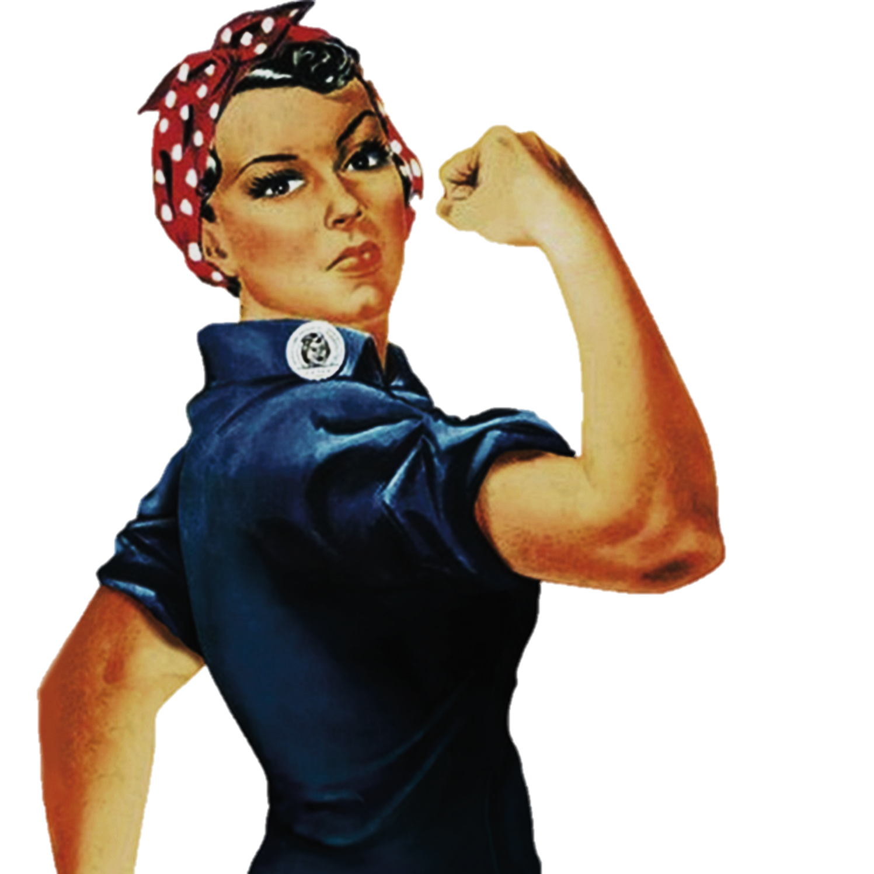
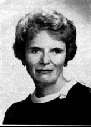

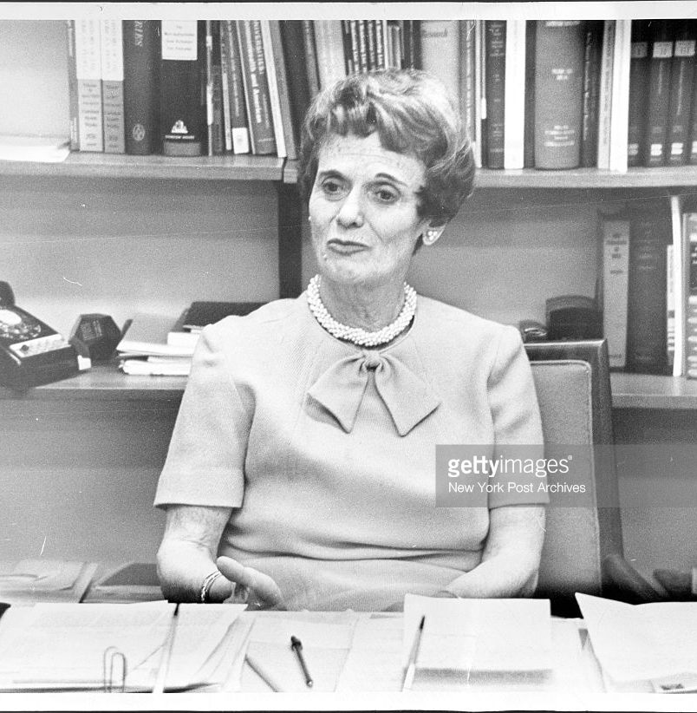
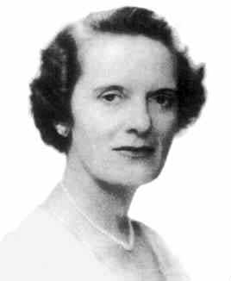
Women
Dr.
Mina
Rees
To change pictures:
Save the picture of the person you wish to use.
Single-left-click the grouped picture/shapes you wish to change on the poster. Single-left-click again on the picture.
Now single-right-click the picture and select “Change Picture” from the menu.
Choose the picture file you saved.
You may wish to single-left-click the grouped picture/shapes and single-left-click the new picture again to adjust its size or crop it—especially useful if the new picture is not the same aspect ratio as the previous one.
DO NOT CHANGE ROSIE THE RIVETER PICTURE!!!
In Technology
1931 received Ph.D.
1952-1953 Deputy Science Director for ONR
1953-1961 Faculty Dean, Hunter College
1971 First woman president of the American Association for the Advancement of Science
No greater wisdom and foresight could have been displayed and the whole postwar development of mathematical research in the United States owes an immeasurable debt to the pioneer work of the Office of Naval Research and to the alert, vigorous and farsighted policy conducted by Dr. Rees.
Mina Rees was eminently intelligent. She comprehended quickly, communicated effectively, and thought creatively. Her ability to attach realizable pieces of basic research to mission-oriented applications of mathematics did much to develop a broadened base of support for mathematicians' work.
What paths will you trailblaze that no one has traveled before?

